Slide 1
Introduction to SAS

Slide 2
What is SAS?
Developed in the early 1970s at North Carolina State University
Originally intended for management and analysis of agricultural field experiments
Now the most widely used statistical software
Used to stand for “Statistical Analysis System”

Slide 3
Introduction to SAS
Need to know
SAS environment
SAS files (datasets, catalogs etc) & libraries
SAS programs
How to:
Get data in
Manipulate data
Get results out

Slide 4
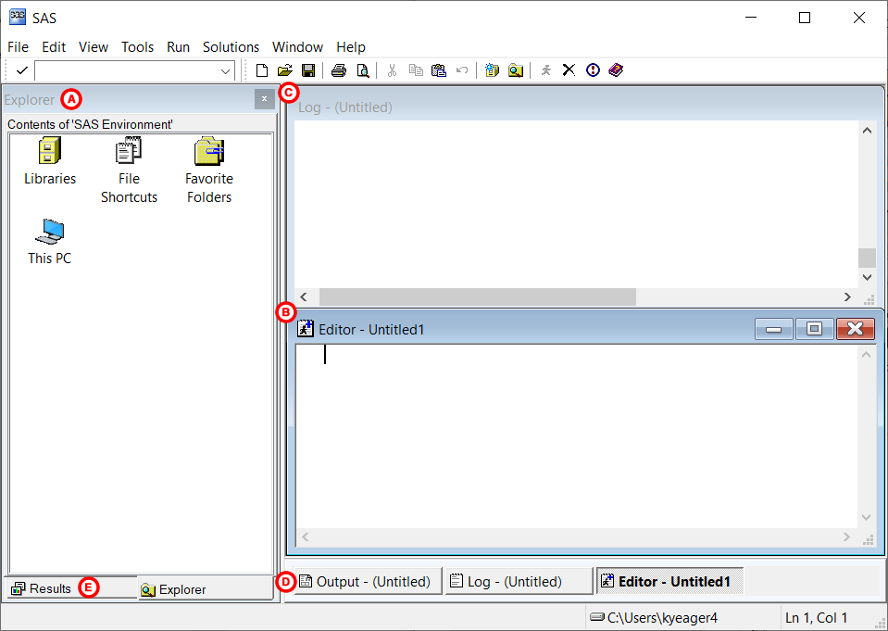
The SAS Environment
When you start SAS, five windows will be open in the SAS environment.
The Explorer, Log, and Editor windows will be immediately visible, while the Results and Output windows will be hidden.

Slide 5
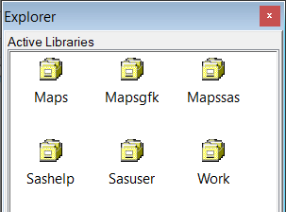
Windows and the purpose of each of them
1. EXPLORER
The Explorer window is where you can browse and view the content in your SAS libraries, or directories where SAS data is stored.
The main icon you’ll want to note is the file cabinet icon for "Libraries". If you double-click on it, you will see icons that look like file cabinet drawers:
Once a dataset has been referenced with a library name, it can be viewed via this window. Just locate the dataset and double-click on it. The data table will appear in the SAS environment.

Slide 6
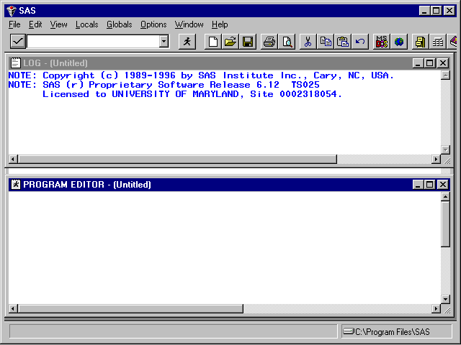
2. EDITOR
The Editor window is where you create and edit your SAS program.
A program is a series of commands (or statements) that tell SAS what actions to do and how to do them.
Program Window: SAS Statements Go Here

Slide 7
3. log
The Log window is one of the most important tools you have to troubleshoot problems in SAS!
This is where error messages and warnings appear that can help you troubleshoot when a program isn’t working.
As you use SAS, the Log window will report the success or failure of any SAS programs or code you execute. Specifically, the Log window will show each line of code that has been executed, how long it took to execute, and what the result was. If there is an error in your code (or if SAS encounters a problem while trying to run your code), it will report error messages or warnings in the Log window.
The Log window uses color-coded text to communicate issues.
Notes appear in blue, Warnings appear in green, and Errors appear in red.
Warnings indicate when SAS found potential issues with the data or task but was still able to run the code.
Errors appear when SAS can not execute the program statements you told it to run.
SAS Log: Results of Program Execution
Tip: Always check your Log window every time you run a program or a piece of a program. This will ensure that you do not miss an Error, Warning, or Note.

Slide 8
4. OUTPUT
The Output window displays the printable results of any analysis you submitted in your program.
Text displayed in the Output window is not editable. You must copy and paste the text into a word processing program or save the output file as a text file and open it in a word processing program in order to edit it.
5. RESULTS
The Results window serves as a table of contents for all output you've created during the current SAS session.
It allows you to quickly navigate through your output by clicking on the command that generated it.
The Results window is a tab within the Explorer window. You can access it by clicking on the Results tab at the bottom of the Explorer window.

Slide 9
SAS SYNTAX RULES
A SAS program is written in the Editor window and contains a series of statements that tell SAS what to do (e.g., import a dataset, give a frequency count of a variable).
You can save your program so that it can be edited and reused after it’s written.
SAS syntax is the set of rules that dictate how your program must be written in order for SAS to understand it. There are some conventions of SAS syntax that new users should know before getting started.
SEMICOLONS
Every statement must end with a semicolon.
This generally corresponds to every line ending in a semi-colon, but sometimes your commands or statements will be more than one line and a semicolon is only necessary at the end of the statement.
Omitting the semicolon is the most common mistake new users make.

Slide 10
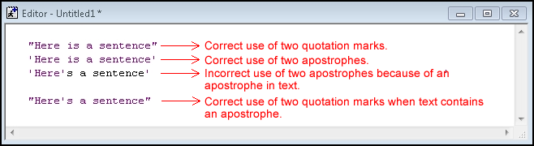
QUOTATION MARKS
SAS recognizes text as long as it is enclosed in quotation marks ("text") or apostrophes ('text’).
It doesn’t matter which one you choose, but be sure each text block starts and ends with the same one.
You will need to enclose text in quotation marks or apostrophes if you need to reference values of a character variable, reference a file directory, or assign a title to your output, to name a few example.
You know you have properly typed text values when SAS changes the color of the words into a purplish-pink color. One word of caution: if your text contains an apostrophe, then you must enclose it with quotation marks. The example text string below shows that SAS recognizes the first two lines as text (indicated by the coloring), but only recognizes part of the text as such in the third line.

Slide 11
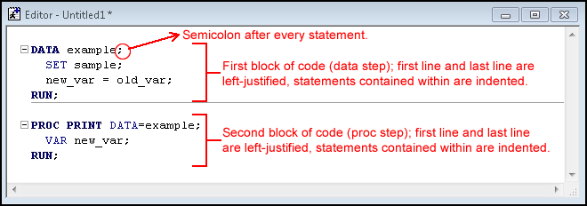
FORMATTING
SAS is more relaxed than other coding languages when it comes to capitalization, indentation, and line breaks.
SAS is not case sensitive; uppercase and lowercase letters are recognized as the same, even for variable names.
Indentations or spacing before a statement are ignored.
Extra lines between statements are ignored.
Multiple statements on the same line are okay, provided they are separated by a semicolon.
A statement can span more than one line, as long as it ends with a semicolon.
Here is an example of how a typical program would be set up, making use of indentations and spacing, one statement per line, and capital letters.

Slide 12
COMMENTS
Lines beginning with an asterisk (*) are treated as comments.
Alternatively, you can enclose comments between /* and */.
A comment is a line or block of text that SAS ignores during the execution of a program.
A well-commented program helps you to remember what your thought process was when you first created the program, and helps other users read what your program is doing.
There are two ways to "comment out" a line of text or code in a SAS program:
Add an asterisk at the beginning of the line and add a semicolon at the end of the text being commented out. All text between the asterisk and the semicolon will be commented out.
Add a forward slash and an asterisk at the beginning of the comment, and place an asterisk and a forward slash at the end of the line.
An example SAS program containing comments might look like this:
* Check the variables in the most recently used dataset using the CONTENTS procedure;
PROC CONTENTS;
RUN;
/* Print the contents of the most recently used dataset using the PRINT procedure.*/ PROC PRINT;
RUN;

Slide 13
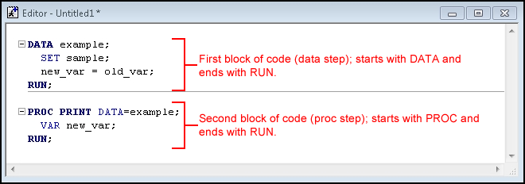
The Data Step vs. The Proc Step
A typical SAS program is organized into blocks of code, called steps.
Specifically, the data step is where data creation and manipulation takes place, and the proc (or procedure) step is where statistical analysis takes place.
Some statements occur outside of the data step or proc steps; these are called global statements. When global statements are executed, their effects are held until the end of the SAS session.
One example is the OPTIONS statement, which allows the user to customize the headings that print when output is generated (among other things).
Another example is the LIBNAME statement, which defines a SAS library.
Every data step begins with the word DATA and every proc step begins with the word PROC.

Slide 14
For the most part, all data and proc steps should end with a RUN statement.
The RUN statement tells SAS to execute the preceding block.
Run Button: Executes all SAS statements in Program editor

Slide 15
Basic Structure of SAS (summary)
There are two main components to most SAS programs
the data step(s) and the procedure step(s).
The data step reads data from external sources, manipulates and combines it with other data set and prints reports. The data step is used to prepare your data for use by one of the procedures (often called “procs”).
The procedure steps perform analysis on the data, and produce (often huge amounts of) output.
The most effective strategy for learning SAS is to concentrate on the details of the data step, and learn the details of each procedure as you have a need for them.

Slide 16
Running a Program
After a program is written, click on the running man icon in the toolbar to execute your program.
If you wish to only run a specific portion of your program, you can highlight the relevant lines of code and then click on the running man.
Tip: It is a good idea to always check your Log after you run a program to look for warnings or errors.

Slide 17
SAS Libraries
SAS libraries allow users to safely store things like data sets and user-defined formats so that they can be accessed without having to reload or re-read them from an external file every time SAS is started.
One or many datasets can be assigned to the same library. A library is assigned a location with a LIBNAME statement in SAS.
LIBNAME statement is one of those global statements that we mentioned earlier.

Slide 18
SAS Libraries
LIBNAME libref 'Folder path name here';
Here the first word (LIBNAME) is the SAS keyword that tells it to create a library.
The second word (libref) is what you name the library. It must be eight or less characters and start with a letter.
Finally, the text in quotes is what path name you tell SAS to assign the library to. (This folder must already exist on your computer.)
Here is an example LIBNAME statement that creates the library named practice and assigns it to a folder in the directory ‘C:\Users\Research\Thesis.’
LIBNAME practice 'C:\Users\Research\Thesis';
The Work Library
AS has a built-in temporary library called Work. The Work library is a place to store data you are working on in your current session.
Because the Work library is temporary, you will lose any datasets you created and stored in the Work library when you close out of your SAS session.

Slide 19
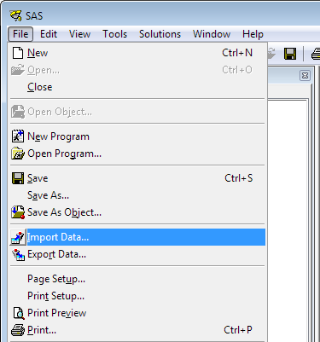
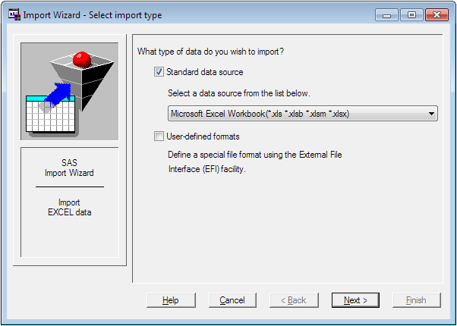
WORKING WITH DATA
Importing Excel Files into SAS Using the Import Wizard

Slide 20
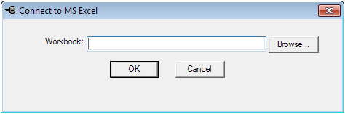
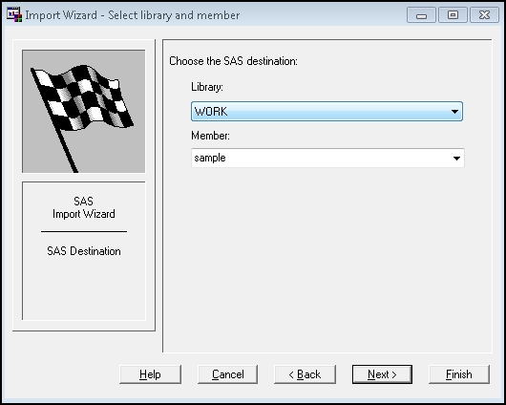
Importing Excel Files into SAS Using the Import Wizard
Now you need to tell SAS where to find the file you want to import. You can either type the file directory into the text box, or click Browse and choose the file to import.
This next step tells SAS where you want to store the newly imported dataset. The first drop-down menu is a list of available libraries that you can choose to store your newly imported SAS dataset in. If you want it to be temporarily stored for now, choose WORK. If you’ve already created a library with a LIBNAME statement, you can choose one of those instead.

Slide 21
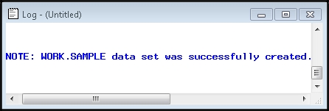
Importing Excel Files into SAS Using the Import Wizard
The last step allows you to save the statements that SAS generates while executing the Import Wizard into an Editor file. This is recommended. This way you have the import steps saved, and you can go back and re-run it or modify it later if you need to. You can type the file directory directly into the text box, or click on Browse to locate a folder to save the program in. Don’t forget to name it. The last step is to click Finish.
How do I know if it worked?
Running the Import Wizard executes statements in SAS – it’s just behind the scenes a bit because the Wizard writes the statements for you – so then the Log window is the first place you should look. If you look in the Log window, you’ll see there was some action:

Slide 22
A. Getting Started
- Primary Windows in SAS:
1. Editor (contains SAS program) : Where code is written or imported, and submitted
2. Log (contains info about the processing of SAS program, including warning/error messages): What happened, including what went wrong
3. Output (reports generated by the SAS program): Results of program procedures that produce output
4. Explorer (enables you to manage SAS files in a Windows environment): Shows libraries (SAS & Windows), their files, and where you can see data, graphs.
5. Results: Shows how the output is made up of tables, graphs, datasets etc
Starting a new SAS Program: a new editor window is automatically opened when the SAS program is started
SAS Data Libraries
- SAS data sets (files) are stored in SAS data libraries
- When a SAS session starts, it automatically creates a temporary (work) & a permanent (sasuser) data library.
The Work library and its SAS data files are deleted after the SAS session ends.
Data files in the Sasuser (permanent) library are saved after the session ends. You can also create and access your own permanent libraries.

Slide 23
B. Processing Basics
SAS Programs:
Steps:
2 Major Steps: 1. DATA: used to read, modify, and create SAS data sets
2. PROC: used to analyze data, perform utility functions, or print reports
Steps end with: (1) RUN statement or (2) QUIT statement or (3) the beginning of another step
A step is a sequence of statements
Statements: 1. Begin with an identifying keyword (i.e. WHERE, TABLES, VAR, etc).
2. Always end with a semicolon
3. Use “/ ” to add modifiers
Comments: (can be used anywhere and are ignored during processing): /*comment*/ or *comment;
Note: Correct unbalanced quotation marks with: * ’ ; * ” ; run ;
You input data into a SAS program from a:(1)existing SAS Data set (2) Excel worksheet or (3) raw data file
You output data from a SAS program into a new SAS Data set created with the DATA step SAS Data Sets have 2 portions:
1. Descriptor portion (contains general info about the data set & variable info)
2. Data portion (variables= columns; observations = rows)

Slide 24
Processing Basics Cont’d
- Use LIBNAME statement to assign a library reference name to a SAS data library:
LIBNAME libref ‘SAS-data-library’ location’;
(i.e. LIBNAME Example ‘C:\MPH2022’;)
- Every SAS data file has a two level name: libref.filename (i.e. EXAMPLE.Lab)
- Default libref is Work if a specific libref name is not specified (i.e. work.Lab;)

Slide 25
Inputting data into a SAS Program
1. Read from an existing SAS data set
LIBNAME libref ‘SAS-data-library location’;
DATA output- SAS- data- set;
SET input- SAS- data- set;
RUN;
2. Read from excel worksheets
a. Using Import Wizard (follow directions)
b. Using SAS code
Example: libname gerbi '\\fshome01pd\ggerbi$\Desktop';
data=Gerbi.Lab
Run;

Slide 26
Inputting data into a SAS Program
Notes:
- Each worksheet in an excel workbook is treated as though it is a SAS data set; each workbook is treated as a data library
Worksheet names appear with a dollar sign at the end of the name

Slide 27
C. Common PROC Steps
1. PRINT: displays all observations, all variables, & an Observations column on the left
PROC PRINT DATA= Sas-data-set;
RUN;
2. MEANS: by default it displays N, MEAN, MIN, MAX, STDDEV; use with VAR statement
PROC MEANS DATA= Sas-data set;
VAR variables(s);
RUN;
- Modifications to the means procedure:
If you would like to modify the descriptive statistics displayed, type the desired terms in the headline.
i.e. PROC MEANS DATA= Sas-data set n mean; would display only N and MEAN data
- CLASS statement: identifies variables whose values define subgroups for analysis (i.e. gender)
3. FREQ: displays frequencies, cumulative frequencies, percentages, and cumulative percentages, use with TABLES
statement
PROC FREQ DATA= Sas-data set;
TABLES variable(s);
RUN;

Slide 28
Common PROC Steps
- Modifications to the freq procedure:
NLEVELS: determines the number of distinct values for each variable (can help to determine duplicates)→ PROC FREQ DATA = Sas-data set <NLEVELS>;
- PAGE: displays only one table per page
- COMPRESS: begins next one way frequency table on same page if there is enough space
-Modifications to the tables statement (should be placed after variable and a forward slash)→
i.e. TABLES age / NOCUM;
- LIST: displays n-way tables in list format
- CROSSLIST: displays n-way tables in column format
- FORMAT: formats the frequencies in n-way tables
- NOCUM, NOPERCENT, NOFREQ, NOROW, NOCOL: suppresses display of various default statistics

Slide 29
Common PROC Steps
4. CONTENTS: displays the descriptor portion of a SAS data set
PROC CONTENTS DATA = Sas-data set;
RUN;
5. UNIVARIATE: displays a variety of descriptive statistics; use with VAR statement
PROC UNIVARIATE DATA= Sas-data set;
VAR variable(s);
RUN;

Slide 30
Common PROC Steps
SORT: rearranges observations in a SAS data set by specified variables, either replaces the original data set or creates a new data set; default is to sort in ascending order; use with BY statement
PROC SORT DATA= input-SAS-data-set;
OUT= output-SAS-data-set; (use the OUT statement only if a new data set is desired) BY variable(s);
RUN;
- Modifications to the sort procedure:
DESCENDING: to sort in descending order (BY DESCENDING variable(s);)
NODUPKEY: deletes observations with a duplicate value (OUT=output-SAS-data-set NODUPKEY;)
EQUALS: maintains the relative order of the observations within the input data set in the output data set for observation with identical BY values (same as above)

